Slide 1
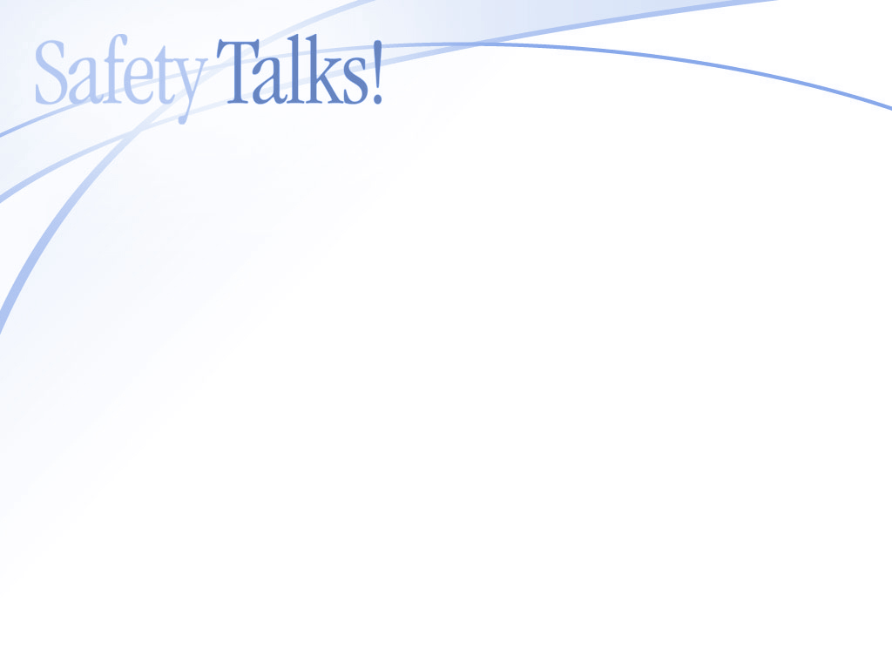
Click to start

Slide 2

Protect Yourself
Against UV Rays
SEASONAL SAFETY T201008-04
©2010 Bongarde

Slide 3
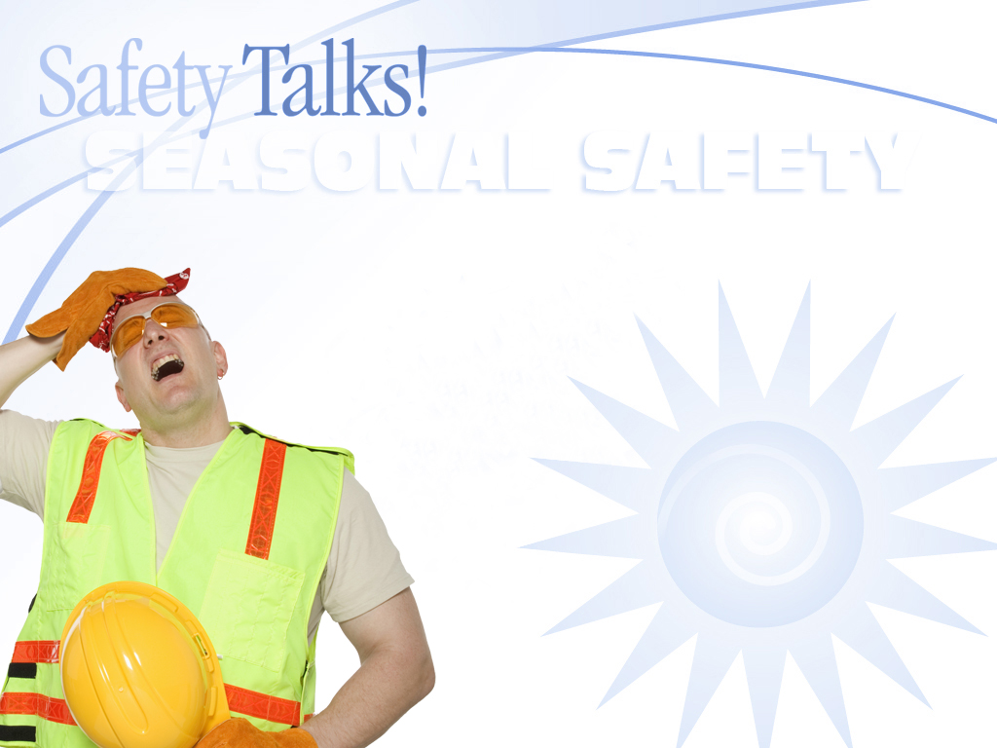
WHAT’S AT STAKE
Working outdoors
Sun blasting down on you
Get a good tan
Without proper skin protection
Deadly skin damage

Slide 4
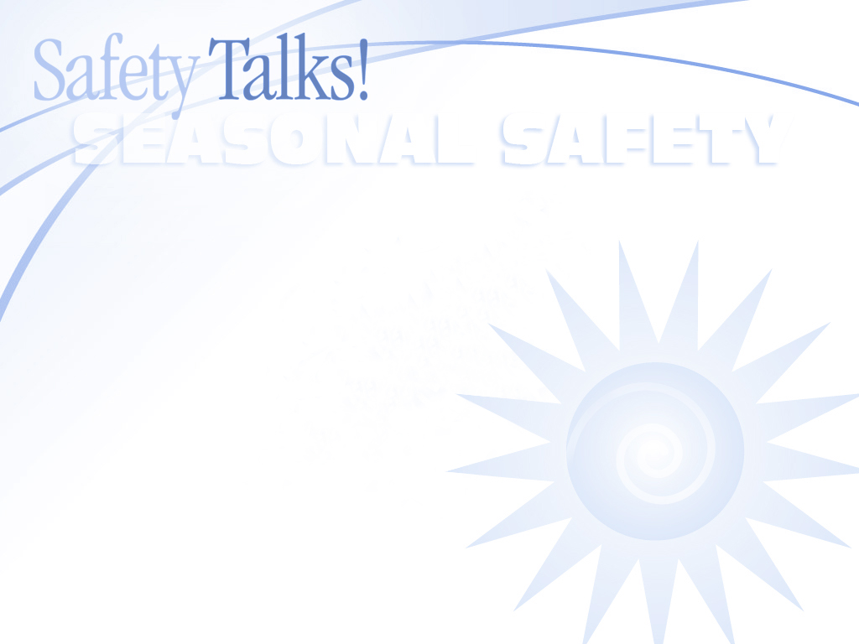
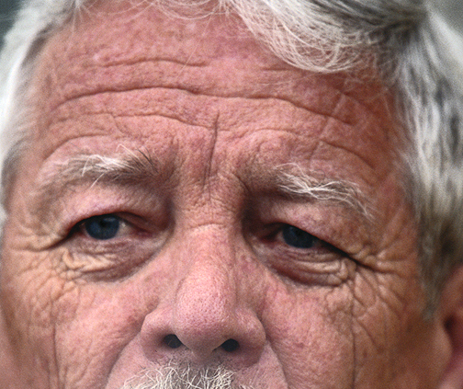
WHAT’S THE DANGER
No such thing as a safe suntan
Non-fatal consequences
Prematurely aged skin, cataracts and other eye problems
Fatal consequences
Skin cancer, melanoma

Slide 5
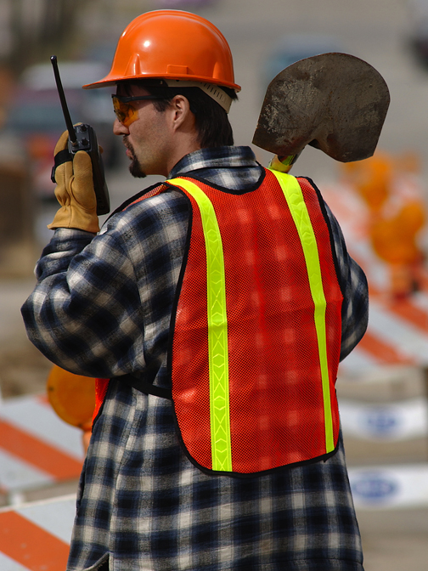
EXAMPLE
Roads and Traffic Authority employee
Damages to his skin after excessive sun exposure
Multiple types of skin cancers
Several surgeries to remove them

Slide 6
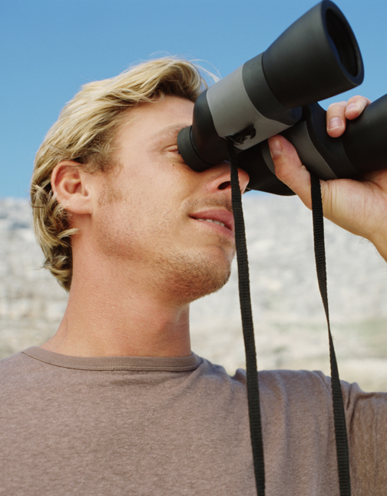
HOW TO
PROTECT YOURSELF
Increased risk of skin cancer:
  Many hours outdoors
  Fair skin and light colored hair
  Freckles or burns first
  Has many moles

Slide 7
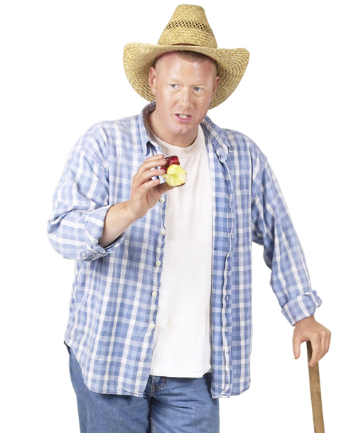
HOW TO PROTECT YOURSELF
Protect yourself:
  Wear clothing that blocks sunlight
  Using sunscreen (SPF of at least 15)
  Wearing a wide-brim hat
  Wearing sunglasses (rated for blocking 99 or 100 percent of UV)
  Limiting your exposure to intense sunlight

Slide 8
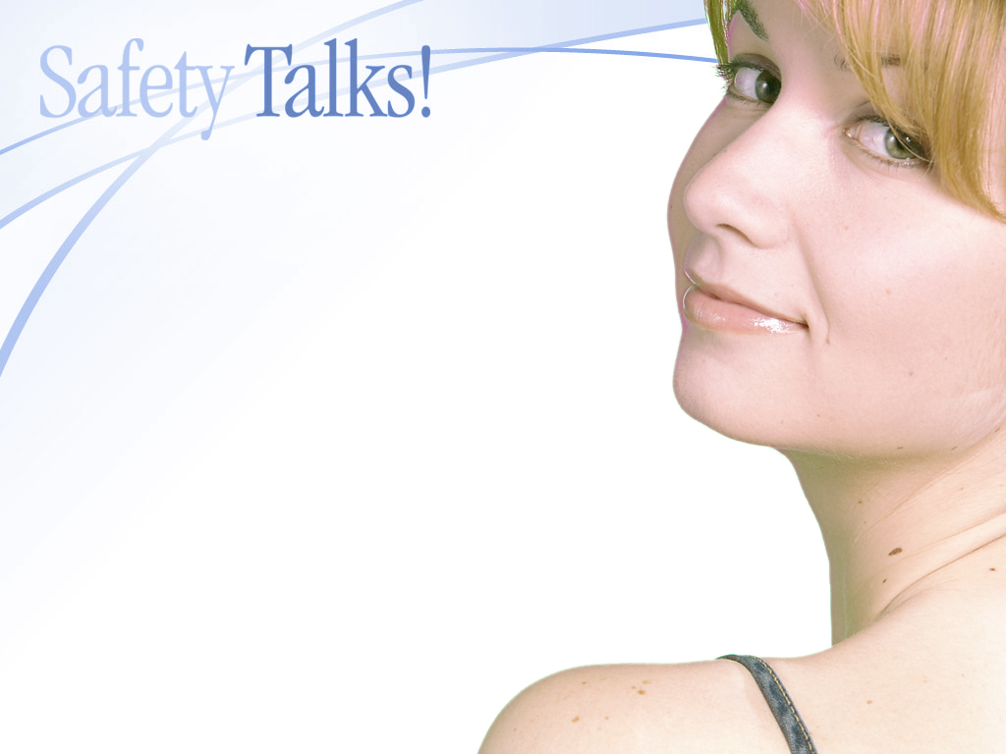
HOW TO
PROTECT YOURSELF
Examine your body regularly
If you detect it early, skin cancer
can almost always be cured
Early warning signs
Spot on your skin
Changes in size, color or shape

Slide 9
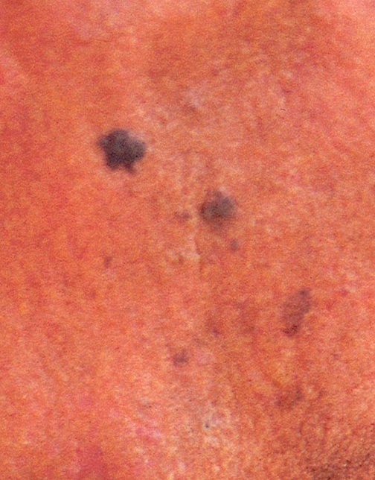
HOW TO PROTECT YOURSELF
Watch out for:
  A red scaly patch that is visibly outlined
  A wax-like pale pearly knob
  A sore that doesn’t heal
Melanoma often begins as a small growth looking like a mole
See a medical professional

Slide 10
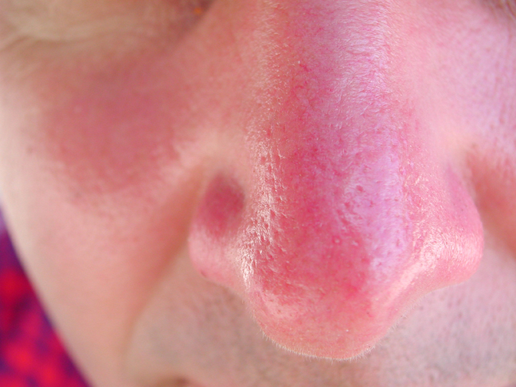
Final Word
Remember, your exposure to UV rays depends on how strong the sunlight is, how long you’re exposed to it and whether your skin is protected.
Consider whether that tan is worth the risk.

