Slide 1

Click anywhere to get started…

Slide 2


LIGHTEN UP FOR EFFICIENCY, SAFETY
Notes:
The Basics of Forklift Safety

Slide 3
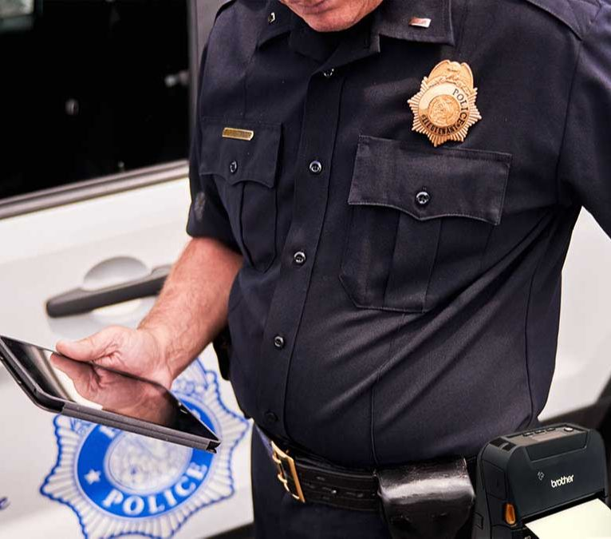
What’s at Stake?
Reduction of injuries, security increase and production gains are factors in play when good workplace practices and policies are implemented.
Notes:
What’s at Stake?
Text here

Slide 4

What’s the Danger?
Examine how the three factors set out in the previous segment playout.
Reduction of injuries
When lighting is inadequate, chances of tripping and falling increased. Injuries by tools, materials and equipment is heightened.
Security increase
Poor lighting is an opportunity for criminal theft and violence.
Productivity
Reducing injuries will boost production and overall comfort for workers.

Slide 5

How to Protect Yourself
The average line worker has no responsibility to maintain good lighting in the workplaces.
Engineers design lighting placement and intensity. Maintenance workers look after replacing burned out light bulbs.
There are 2 roles a worker has in a good workplace lighting policy.
First, you make suggestions for improving the light in your work area.
Second, report any damage or defects in your workplace lighting, such as fluorescent tubes in need of replacement, outdoor lighting damaged by vandals or defects that could cause fire or shock.
Notes:
How to Protect Yourself
Machines of every description have standard operating procedures which include a “checklist” for its safe operation. Forklifts are no exception. There are procedures and protocols for the safe and effective use of the forklift.
These operating procedures are rooted out of common sense but are too often ignored or forgotten.

Slide 6

How to Protect Yourself
The brightest light is not necessarily the best light. You may need some contrast between light and dark. The color and sheen of the work surface also makes a difference. When things are all the same color, it can be hard to see detail.
Make sure permanent wiring is installed for any new light. Don't rely on extension cords.
Lighting around computer workstations can be tricky. The glare from a light or window can make it difficult to see the screen. Rearranging the work station or installing an anti-glare filter are two ways to fix this problem.
Notes:
How to Protect Yourself
Follow safe speed limits – Drive only fast as you can comfortably walk. Forklifts can’t travel safely at high speeds. Without loads, they aren’t weighted and are especially unstable.
Keep the load low – While moving, forks should be low, with the mast tilted slightly back.
Maintain good visibility – If a load blocks forward vision, drive backwards.
Watch the slope – Back down slopes that have an incline greater than10 percent. Make sure your back up alarm is working properly.
Never carry hitchhikers – They are unsecured and can easily fall off and be injured.
Leave aisle room – Allow space for pedestrian and other traffic. Be alert at intersections. Honk your horn before and while you enter an intersection, even if it doesn’t appear to be busy.
Park safely – On a hill, always block the wheels, lower forks and set the parking brake.

Slide 7
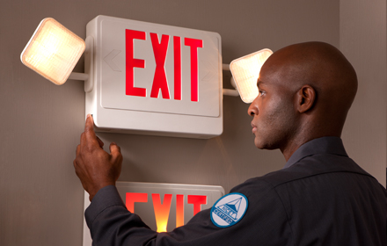
How to Protect Yourself
Many injuries from falls happen in poorly lit halls, stairwells and storage rooms. Good lighting and clean, light-colored walls are two solutions.
Temporary wiring and lighting, must comply with codes. Defective or undersized wiring can cause fires and electric shocks. Inspect temporary lighting systems frequently. Replace burned out bulbs and make sure bulb guards stay in place.
Emergency lighting saves lives by helping people escape in case of fire or another crisis. Make sure emergency lights stay in good condition. Fumes, dust and grease prevent emergency lights from working. Make sure these lights are maintained regularly, and report problems.
Notes:
How to Protect Yourself

Slide 8

Final Word
Good lightning can also improve personal security when you travel in and out of your working place and through remote areas of the plant or grounds. Lights around doorways and in the parking, lots are important in preventing assaults and other injury incidents such as falls.
Notes:
Final Word

