Slide 1

Click anywhere to get started…

Slide 2
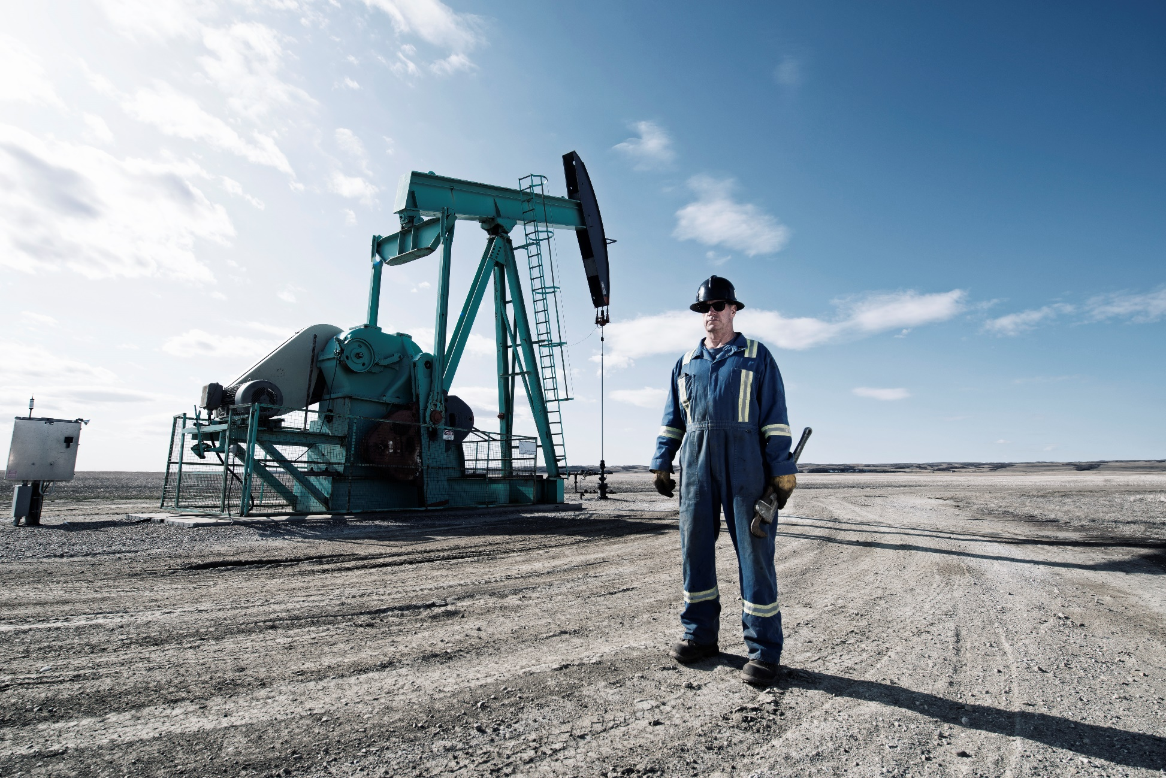


HOUSEKEEPING FOR OIL & GAS

Slide 3

What’s at Stake?
Employers and employees should be mindful about safety issues in oil and gas industry. One needs to understand the constant pressure that comes with production and efficiency, that drilling projects are expensive, time-sensitive, and physically demanding. This will take its toll on health and safety in the oil and gas industry.

Slide 4
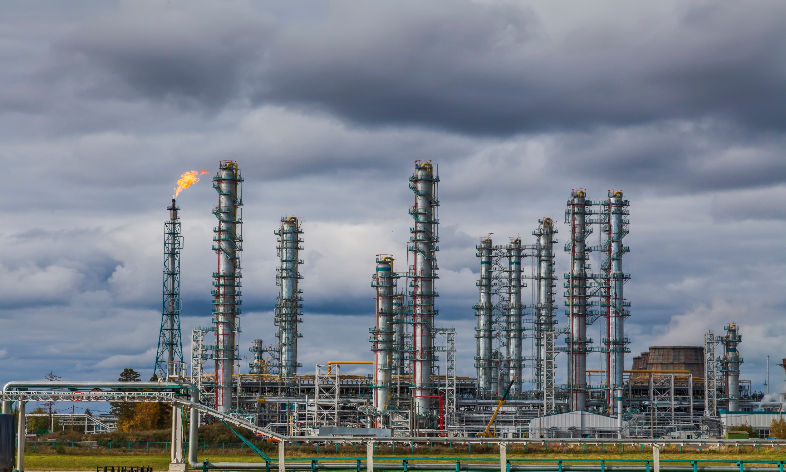
What’s the Danger?
The Bureau of Labor Statistics (2015) revealed that out of 120 workplace deaths in the mining, oil and gas extraction industry, 74 of them occurred within the support activities for oil and gas operations.
The constant pressure of efficient productivity due to the high cost of drilling projects, time away from home, long workdays, and high physical demands takes a hefty toll on workers. These factors can ultimately affect worker safety.
Workers are susceptible to motor vehicle accidents, contact injuries, slips, trips, and falls and encounter fires, explosions, chemical exposure, and confined space issues.

Slide 5

How to Protect Yourself
Oil and Gas Good Housekeeping
“Good Housekeeping” must be practiced day-by-day. Workers must be reminded that it is not just a “slogan”.
Good Housekeeping Benefits
1. Reduce drilling costs.
2. Increase hole drilled.
3. Improve control of drilling.
4. Conserve materials and parts.
5. Decrease rig down time.
6. Use space more efficiently.
7. Open access routes and enable better movement.
8. Lower incident rates on the rig.
9. Build higher crew morale.
10. Reduce rig fire hazards

Slide 6
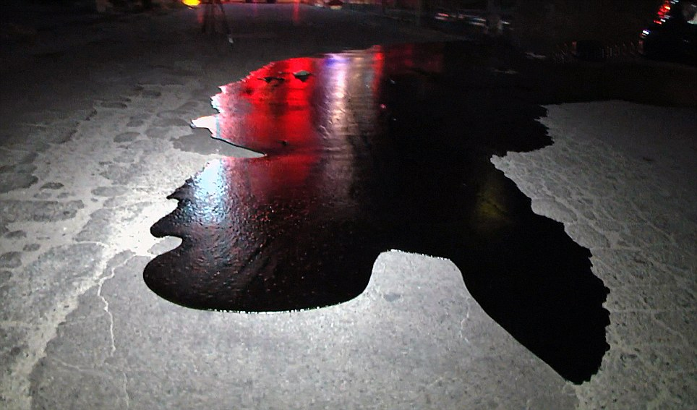
How to Protect Yourself
Housekeeping Practices:
Put a tool back in the rack when you are finished using it.
Sweep up or wash off any dirt or mud as soon as you can.
Repair those loose steps, rickety handrails (check the base sockets and welds) and loose walkways.
Keep cables, slings, chains, rope (catline), etc. coiled up and off the floor when not in use.
Do not allow oil to collect on the rig floor or in the cellar.
Do not block fire extinguishers.
Do not block emergency exit routes.

Slide 7

How to Protect Yourself
Oil and Gas Safety Tips
Talk with your local emergency response team in the community.
Invest in a safety training program that educates & unites workers.
Keep in touch with workers and their mental health to foster a “workers culture”.
Be sure workers understand their roles and hazards at all times.
Remind everyone in the workplace that housekeeping is fundamental for workplace safety.
Workers should be informed and warned with signs. Communicate clearly. Keep all information and instructions updated.
Monitor employee driving behavior and habits.

Slide 8
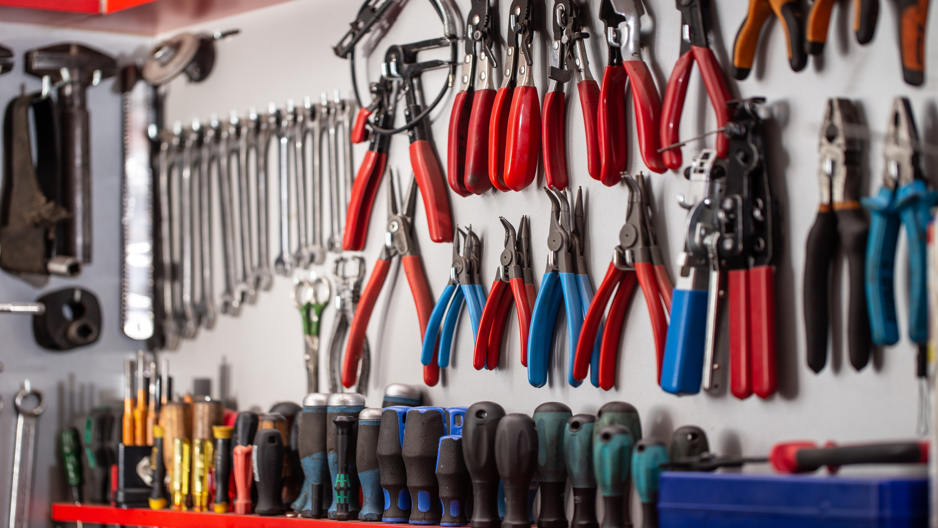
Final Word
Good housekeeping is the bedrock of the start of sound safety protocols and programs in the oil and gas sector. Without a buy-in by workers and owners, safety of workers is severely compromised.

