Slide 1

Click anywhere to get started…

Slide 2
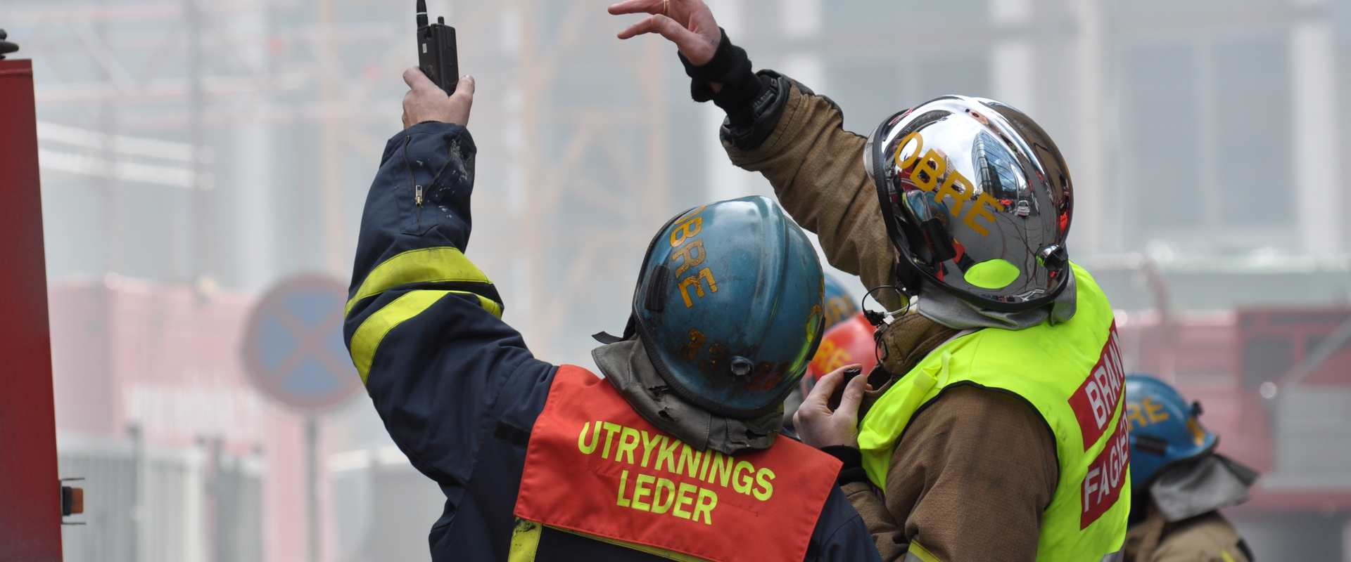

EMERGENCY PLANNING SAVES LIVES
Notes:
EMERGENCY PLANNING SAVES LIVES

Slide 3
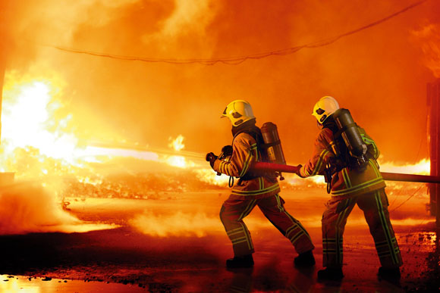
What’s at Stake?
Unexpected emergencies happen every year in this country. Your company needs an Emergency Response Plan to cover all expected and unexpected disasters. All employees must be trained in the roles they will play in an emergency.
Notes:
What’s at Stake?
Unexpected emergencies happen every year in this country. Your company needs an Emergency Response Plan to cover all expected and unexpected disasters. All employees must be trained in the roles they will play in an emergency.

Slide 4
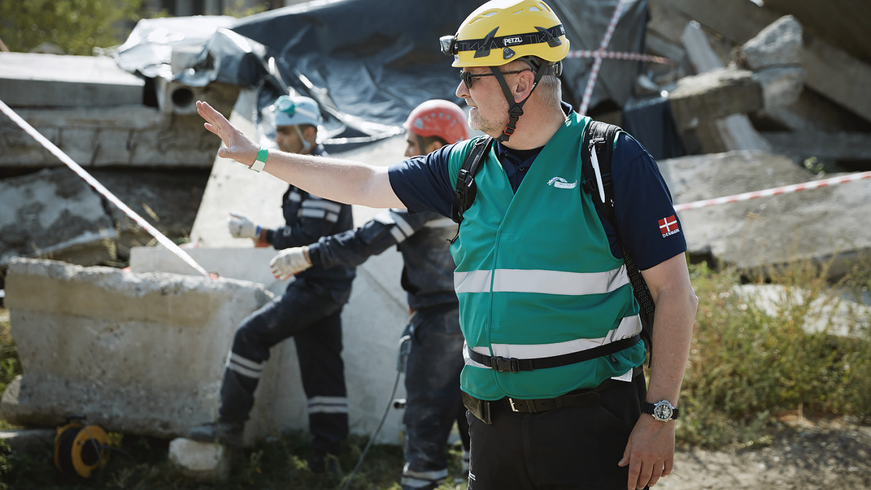
What’s the Danger?
On a construction site someone shouts a warning. You look around and see a tornado bearing down on your work site.
A freight train carrying hazardous chemicals derails behind your plant. It splits apart and bursts into flame. Do you know what to do in either situation?
Notes:
What’s the Danger?
On a construction site someone shouts a warning. You look around and see a tornado bearing down on your work site.
A freight train carrying hazardous chemicals derails behind your plant. It splits apart and bursts into flame. Do you know what to do in either situation?

Slide 5
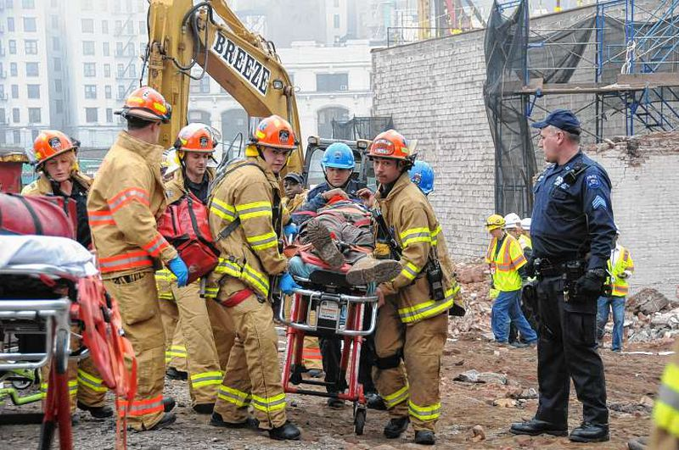
How to Protect Yourself
An Emergency Response Plan is basically a “How Do We Get Out of Here Safely” plan. A good plan should anticipate all possible emergencies as well as all natural and manmade disasters that could occur.
Employees should regularly practice and review emergency response. Practice will expose errors in the plan which could result in lost lives.
Notes:
How to Protect Yourself
An Emergency Response Plan is basically a “How Do We Get Out of Here Safely” plan. A good plan should anticipate all possible emergencies as well as all natural and manmade disasters that could occur.
Employees should regularly practice and review emergency response. Practice will expose errors in the plan which could result in lost lives.

Slide 6
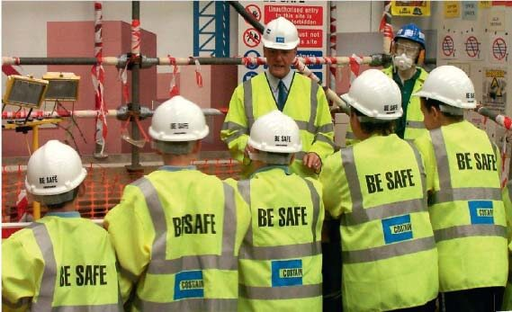
How to Protect Yourself
Guidelines to prepare for workplace emergencies are:
Know where your emergency telephone numbers are located and which agency to contact first.
Know where the two nearest escape routes are located.
Learn to use a fire extinguisher. You should use it on a small fire only. If the fire gets out of hand, leave the area. Unnecessary heroics have killed many employees.
Learn how and when to operate internal alarm systems.
Know how to find and operate eye wash units and safety showers. These should be clearly marked and easily accessed.
Notes:
How to Protect Yourself
Guidelines to prepare for workplace emergencies are:
Know where your emergency telephone numbers are located and which agency to contact first.
Know where the two nearest escape routes are located.
Learn to use a fire extinguisher. You should use it on a small fire only. If the fire gets out of hand, leave the area. Unnecessary heroics have killed many employees.
Learn how and when to operate internal alarm systems.
Know how to find and operate eye wash units and safety showers. These should be clearly marked and easily accessed.

Slide 7
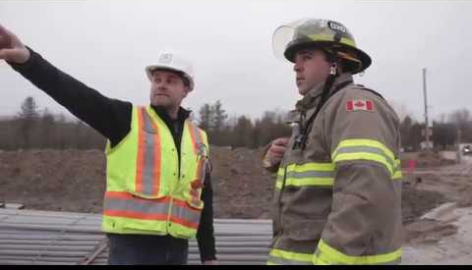
How to Protect Yourself
Everyone should be aware of the location of first aid supplies, and your crew should have the proper training to use them.
In a natural disaster such as an earthquake, flood or tornado, know where to go and what not to do are vital.
Notes:
How to Protect Yourself
Everyone should be aware of the location of first aid supplies, and your crew should have the proper training to use them.
In a natural disaster such as an earthquake, flood or tornado, know where to go and what not to do are vital.

Slide 8
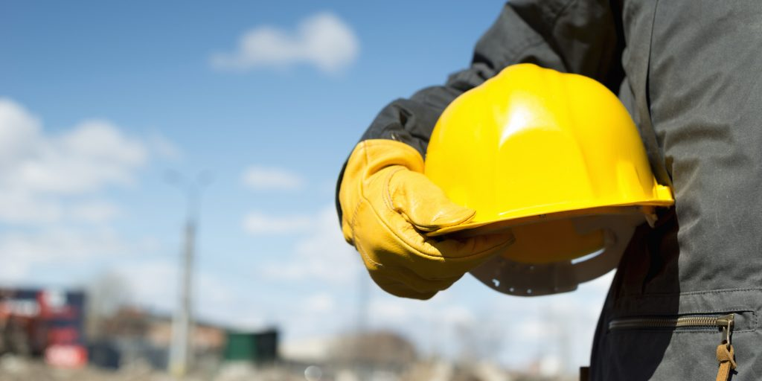
Final Word
Unexpected emergencies occur every day in factories, plants, offices and warehouses, as well as construction sites, airports and train/vehicle intersections. Ignoring the possibility will not prevent one from occurring. Knowing your part in the Emergency Response Plan could make all the difference.
d
Notes:
Final Word
Unexpected emergencies occur every day in factories, plants, offices and warehouses, as well as construction sites, airports and train/vehicle intersections. Ignoring the possibility will not prevent one from occurring. Knowing your part in the Emergency Response Plan could make all the difference.

