Slide 1

Click anywhere to get started…

Slide 2
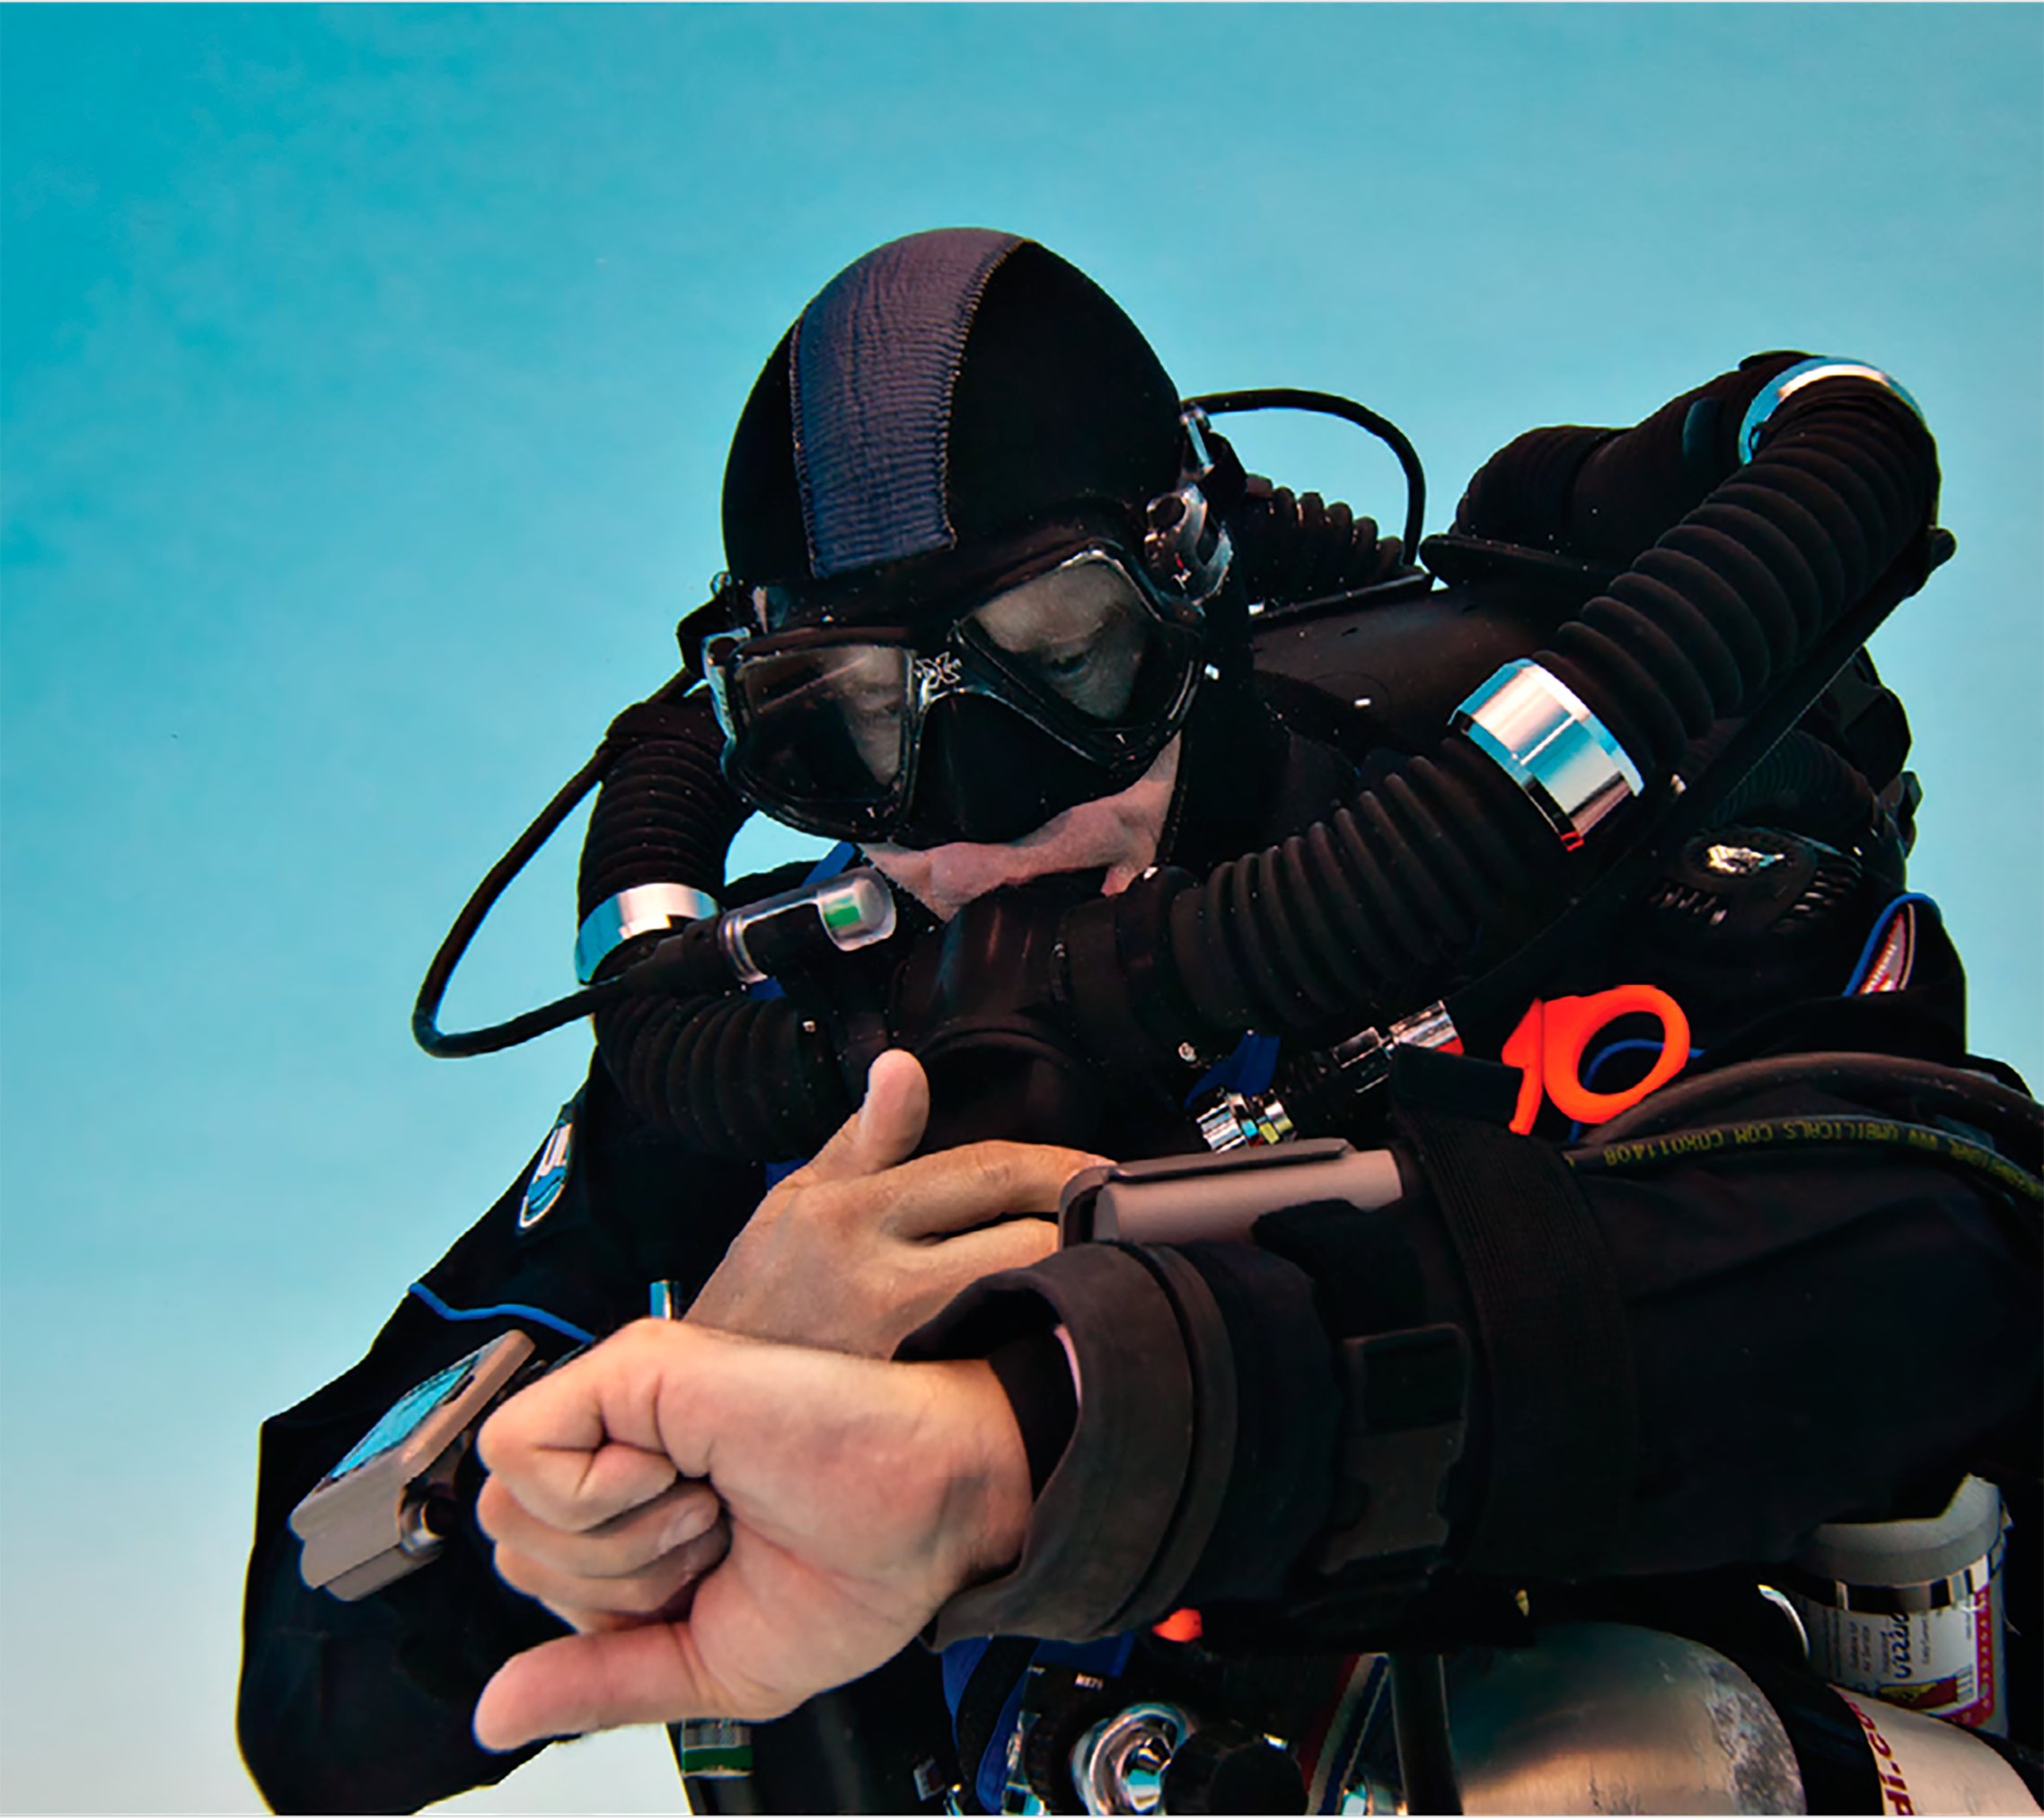

DANGERS FOR DIVERS
Notes:
DANGERS FOR DIVERS

Slide 3
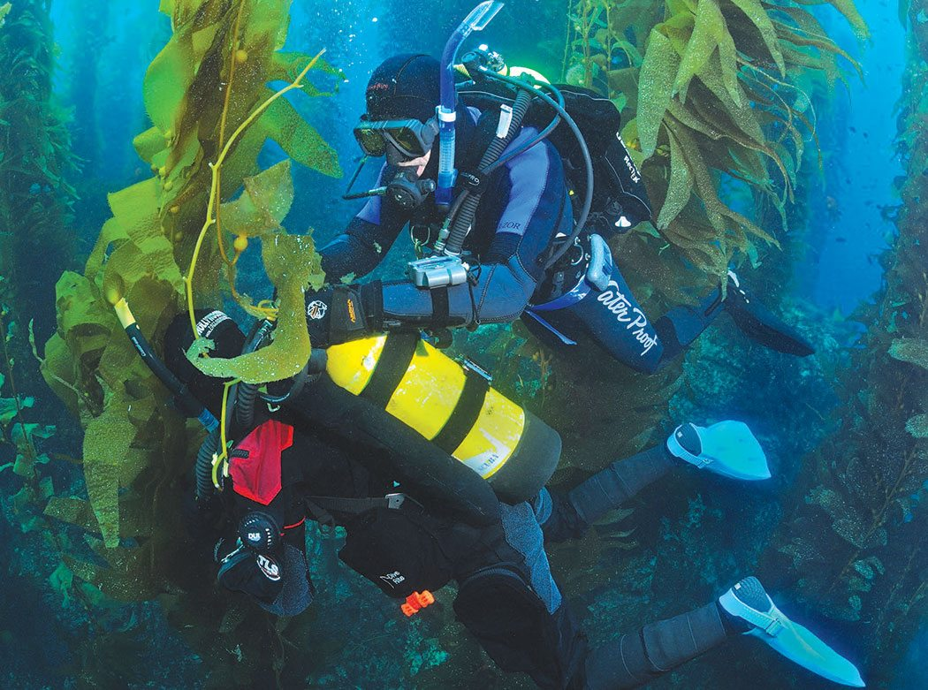
What’s at Stake?
Each year hundreds of divers become entangled in vegetation, run out of air, get caught in small spaces or get the “bends”.
Notes:
What’s at Stake?
Each year hundreds of divers become entangled in vegetation, run out of air, get caught in small spaces or get the “bends”. These divers are at risk every time whether harvesting seafood, repairing ships or retrieving golf balls from ponds.

Slide 4
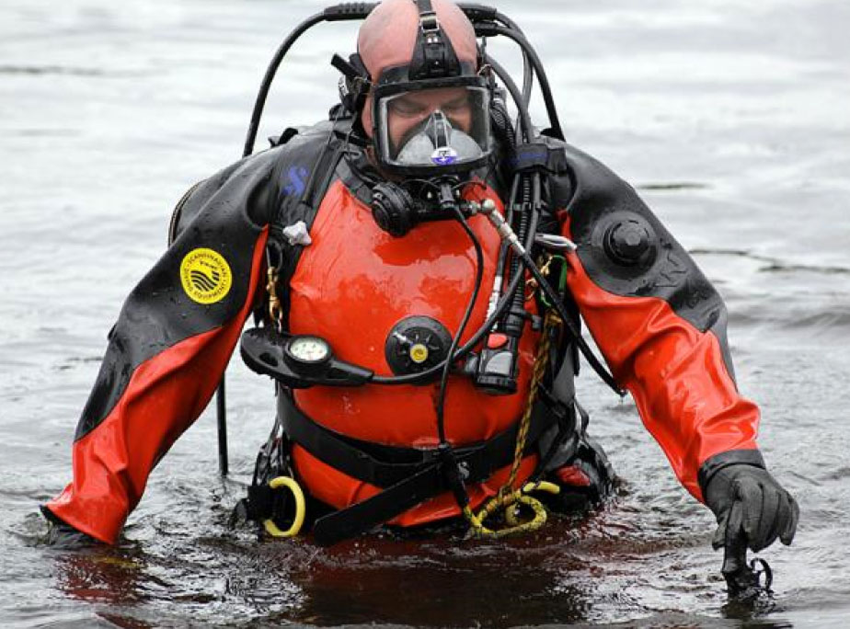
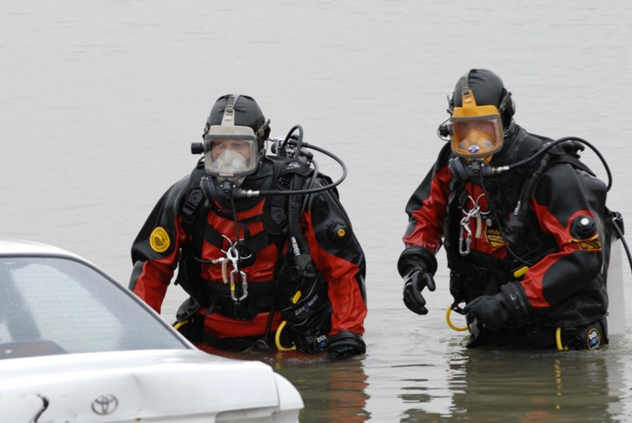
What’s the Danger?
Careful planning, preparation and strict adherence to safety procedures is essential in diving operations.
Divers need to be properly trained and qualified. Many divers have died trying to rescue others or because there was no one to rescue them.
Notes:
What’s the Danger?
There is the undeniable importance of careful planning, preparation and strict adherence to safety procedures.
Only those properly trained and qualified should undertake diving. As usual and predictable, human error is responsible for virtually every dive emergency. Many divers have died trying to rescue others or because there was no one to rescue them.
Example
A worker drowned while completing routine underwater maintenance on a small boat. The man had been working below the surface for more than an hour when his co-workers became concerned and pulled his rescue line. The diver failed to surface, and by the time a second diver arrived the worker had died; his rescue line caught on a propeller and he was unable to see in the murky water.

Slide 5
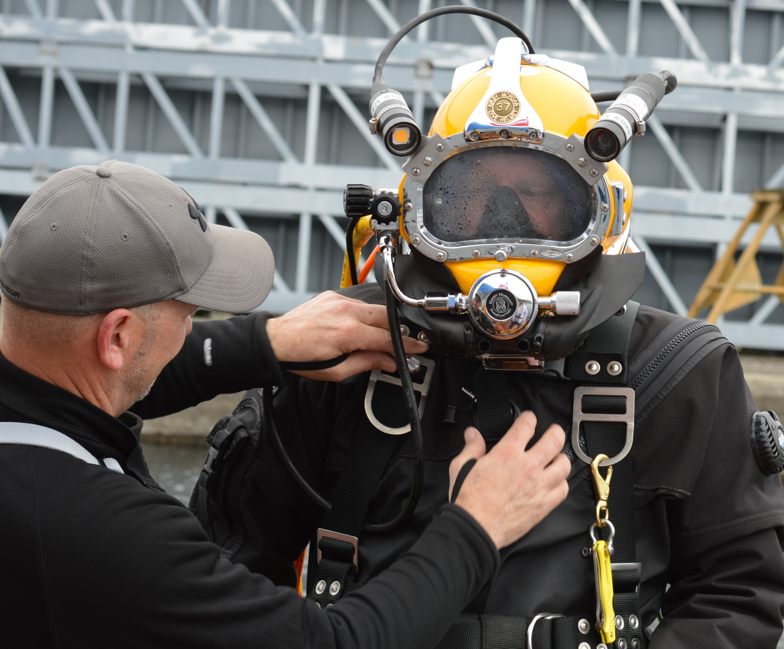
How to Protect Yourself
REQUIREMENTS FOR DIVERS TO MAINTAIN SAFETY.
Dive only if a supervisor and standby diver (ready to enter the water within one minute) are present. One of these people must know CPR.
Dive only if properly trained to do so. A recreational scuba certificate is not adequate.
Evaluate potential hazards before each dive, including weather conditions, water conditions and entanglement hazards such as weeds, netting and fishing lines.
Maintain continuous contact with someone on the surface and with your diving partner.
Leave the water when other divers do and never re-enter with a depleted air supply.
Notes:
How to Protect Yourself
The minimum requirements for divers to maintain safety are as follows:
Dive only if a supervisor and standby diver (ready to enter the water within one minute) are present. One of these people must know CPR.
Dive only if properly trained to do so. A recreational scuba certificate is not adequate for occupational diving.
Evaluate potential hazards before each dive, including weather conditions, water conditions and entanglement hazards such as weeds, netting and fishing lines.
Maintain continuous contact with someone on the surface and with your diving partner (if applicable).
Leave the water when other divers do and never re-enter with a depleted air supply.

Slide 6
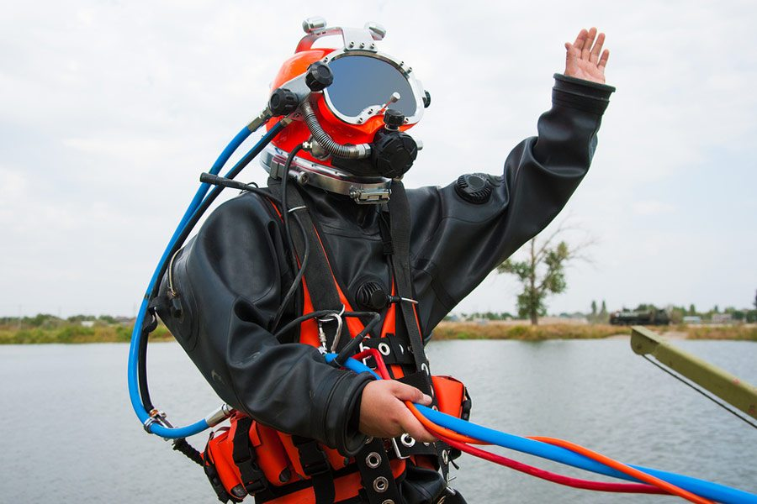
How to Protect Yourself
Watch for signs of decompression sickness (the bends) including skin rash, extreme fatigue, painful joints and paralysis. Decompress under a supervisor’s guidance.
Check your equipment carefully before each dive and have it verified by the dive coordinator.
Carry a knife and alternate air source such as a pony bottle; a small cylinder strapped to a diver’s main tank for emergency use.
Wear a rescue line connecting you to the surface. Use a buoy to mark your location while in open water.
Ensure all machines you are diving near are locked out and secure, including intakes, pipes and tunnels. Have additional rescue divers available if the risk of entrapment is high.
Notes:
How to Protect Yourself
Watch for signs of decompression sickness (the bends) including skin rash, extreme fatigue, painful joints and paralysis. Decompress under a supervisor’s guidance.
Check your equipment carefully before each dive and have it verified by the dive coordinator.
Carry a knife and alternate air source such as a pony bottle; a small cylinder strapped to a diver’s main tank for emergency use.
Wear a rescue line connecting you to the surface. Use a buoy to mark your location while in open water.
Ensure all machines you are diving near are locked out and secure, including intakes, pipes and tunnels. Have additional rescue divers available if the risk of entrapment is high.

Slide 7
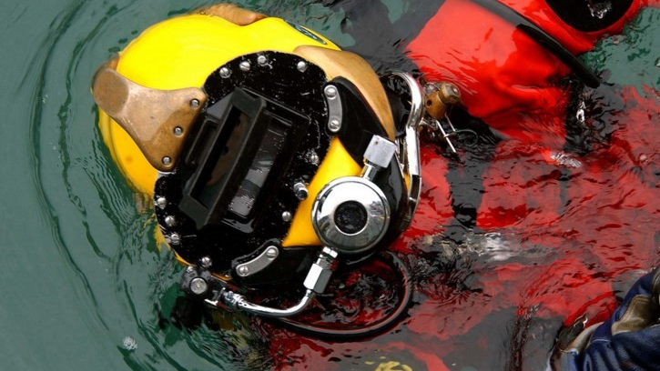
Final Word
Occupational diving is exacting work with absolutely no room for error. Careful planning and strict adherence to safety guidelines are essential for keeping dives from turning disastrous.
Notes:
Final Word
Occupational diving is exacting work with absolutely no room for error. Careful planning and strict adherence to safety guidelines are essential for keeping dives from turning disastrous.

