Slide 1

Click anywhere to get started…

Slide 2

ASSURED GROUNDING
Notes:
ASSURED GROUNDING

Slide 3
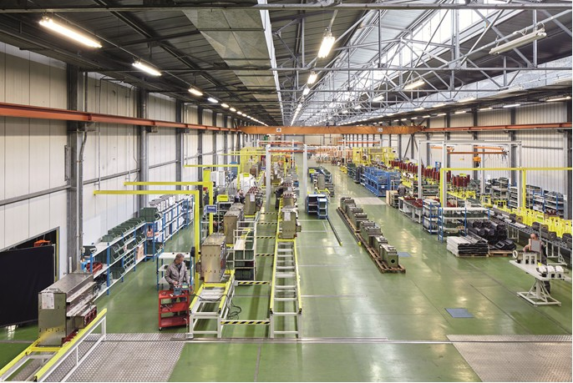
What’s at Stake?
The assured equipment grounding conductor program covers all cord sets, receptacles which are not a part of the permanent wiring of the building or structure, and equipment connected by cord and plug which are available for use or used by employees.
Engineers, electricians, and other workers deal with electricity directly, including working on overhead lines, electrical installation and circuit assemblies. Others, such as office workers, farmers, and construction workers work with electricity indirectly and may also be exposed to electrical hazards.
Notes:
What’s at Stake?
The assured equipment grounding conductor program covers all cord sets, receptacles which are not a part of the permanent wiring of the building or structure, and equipment connected by cord and plug which are available for use or used by employees.
Working with electricity can be dangerous. Engineers, electricians, and other workers deal with electricity directly, including working on overhead lines, electrical installation and circuit assemblies. Others, such as office workers, farmers, and construction workers work with electricity indirectly and may also be exposed to electrical hazards.
Simple mistake results in a tragic accident
A die setter had been electrocuted because someone had wired a 480-volt extension cable incorrectly. He had placed one of the phase conductors on the ground terminal during assembly. This simple mistake ultimately resulted in a tragic accident.
Both NFPA 70E and OSHA recognize the dangers associated with temporary power cables. Therefore, employers who use extension cables energized above 125 volts, are required to institute an AEGC or use a GFCI to prevent accidents like the one I have just described.

Slide 4
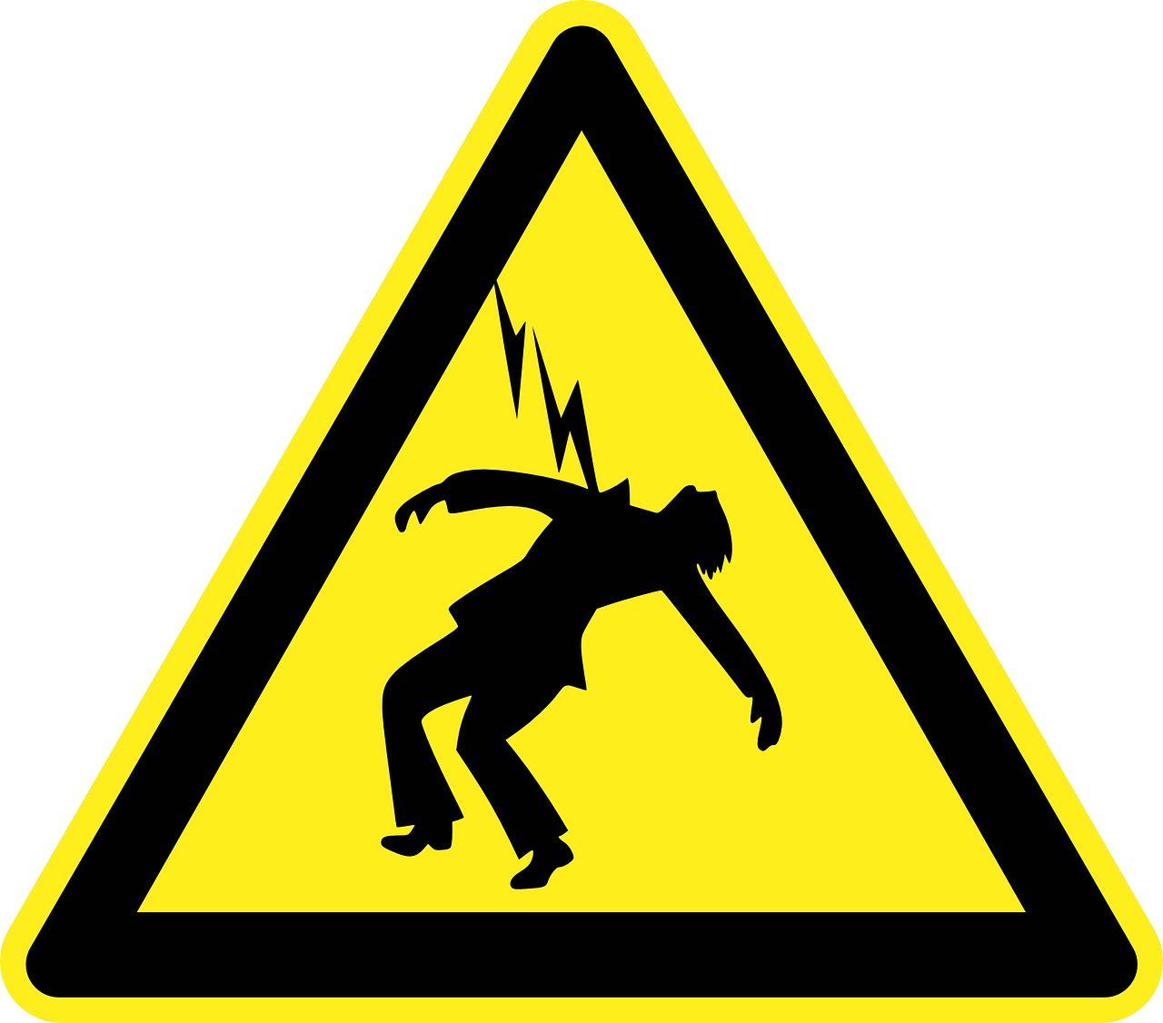
What’s the Danger?
Places of work generally have power nominally supplied at 230 volt (single phase) and 400 volts (3 phase) although some larger workplaces will receive electricity at a higher supply voltage.
The main hazards with electricity are:
contact with live parts causing shock and burns
faults which could cause fires;
fire or explosion where electricity could be the source of ignition in a potentially flammable
Notes:
What’s the Danger?
Places of work generally have power nominally supplied at 230 volt (single phase) and 400 volts (3 phase) although some larger workplaces will receive electricity at a higher supply voltage. The information below relates to workplaces using 230- and 400-volt supplies.
The main hazards with electricity are:
contact with live parts causing shock and burns
faults which could cause fires;
fire or explosion where electricity could be the source of ignition in a potentially flammable or explosive atmosphere, e.g. in a spray paint booth.

Slide 5
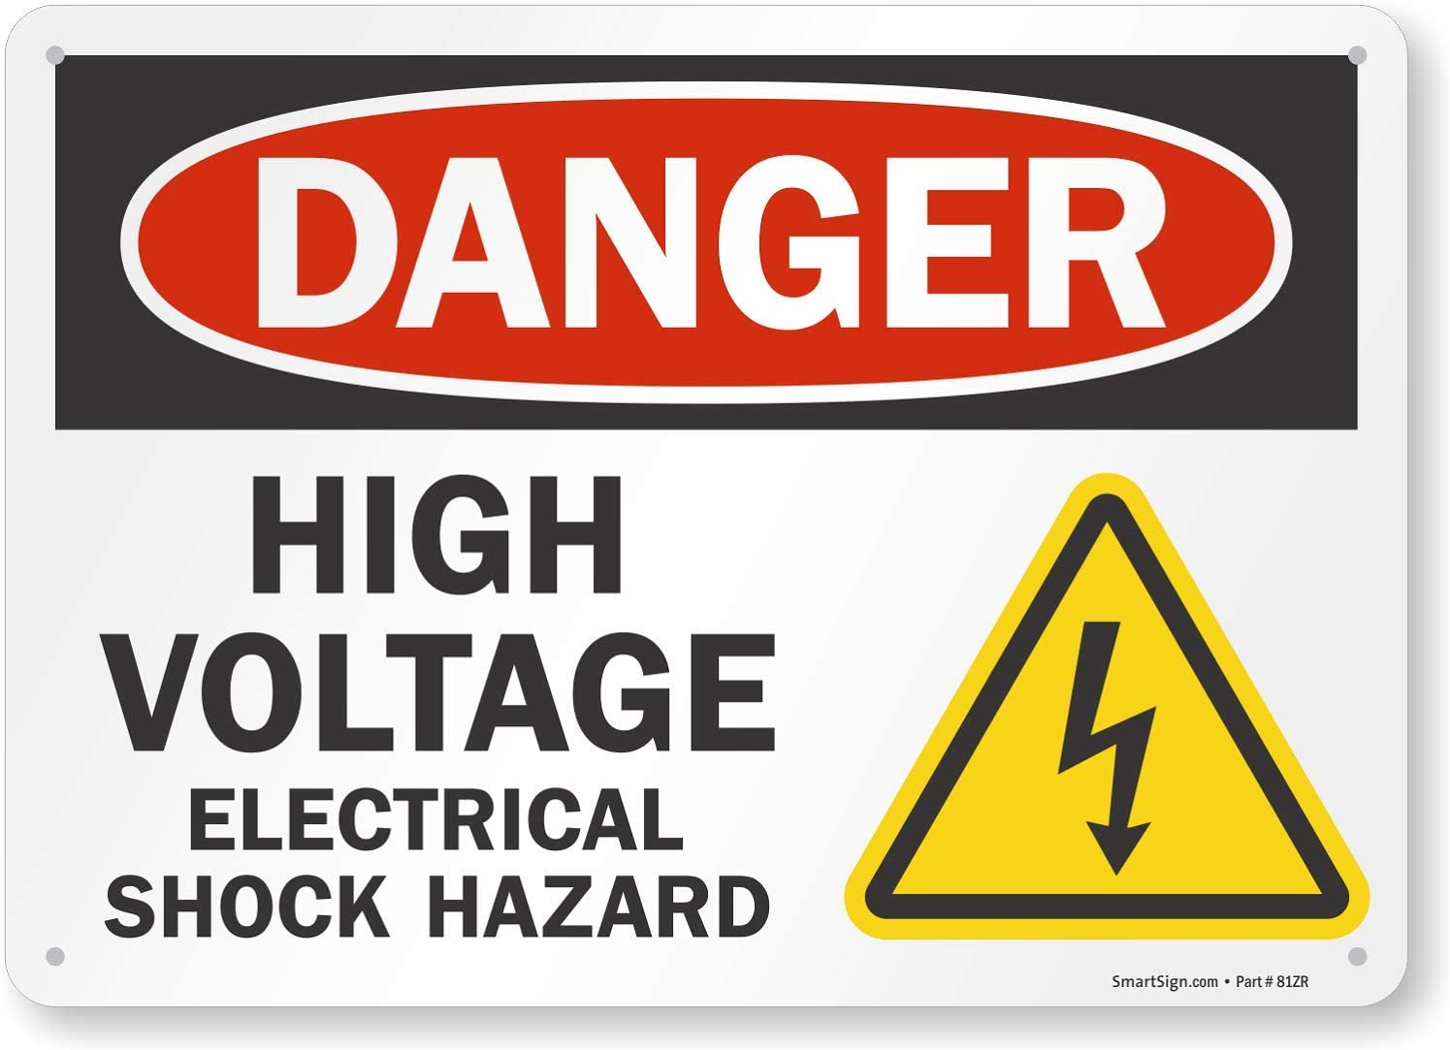
What’s the Danger?
The severity of the effect electric shock has on your body:
The level of voltage
The amount of body resistance you have to the current flow
The path the current takes through your body
The human body is a good conductor of electricity. If you touch a person while they are in contact with the electrical source, the electricity will flow through your body causing electrical shock.
Notes:
What’s the Danger?
It is the level of voltage the body is exposed to and the resistance to flow of electrical current offered by the body that determines the impact of exposure to electricity. The following factors determine the severity of the effect electric shock has on your body:
The level of voltage
The amount of body resistance you have to the current flow
The path the current takes through your body
The length of time the current flows through your body
If a worker has come into contact with electricity the worker may not be able to remove themselves from the electrical source. The human body is a good conductor of electricity. If you touch a person while they are in contact with the electrical source, the electricity will flow through your body causing electrical shock. Firstly, attempt to turn off the source of the electricity (disconnect). If the electrical source cannot readily and safely be turned off, use a non-conducting object, such as a fiberglass object or a wooden pole, to remove the person from the electrical source.

Slide 6
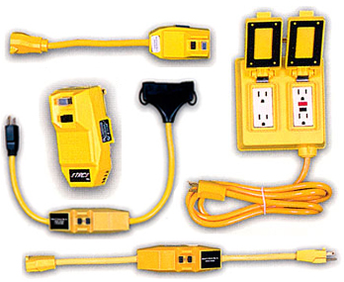
How to Protect Yourself
If an Assured Equipment Grounding Conductor Program (AEGCP) is used in place of ground-fault circuit interrupters (GFCIs) for ground-fault protection, the following minimum requirements apply.
Keep a written description of the program at the jobsite.
Designate one or more competent persons to implement the program.
Visually inspect all cord sets, attachment caps, plugs and receptacles, and any equipment connected by cord and plug, before use each day.
Notes:
How to Protect Yourself
If an Assured Equipment Grounding Conductor Program (AEGCP) is used in place of ground-fault circuit interrupters (GFCIs) for ground-fault protection, the following minimum requirements apply, though additional tests or procedures are encouraged:
Keep a written description of the program at the jobsite. Outline specific procedures for the required equipment inspections, tests, and test schedule, and make them available to OSHA and to affected persons upon demand.
Designate one or more competent persons to implement the program. OSHA defines a competent person as someone who is a) qualified to identify hazards, and b) authorized to take prompt corrective measures.
Visually inspect all cord sets, attachment caps, plugs and receptacles, and any equipment connected by cord and plug, before use each day. If you see any external damage, such as deformed or missing pins, damaged insulation, etc., or discover internal damage, take the equipment out of use until it is repaired.

Slide 7
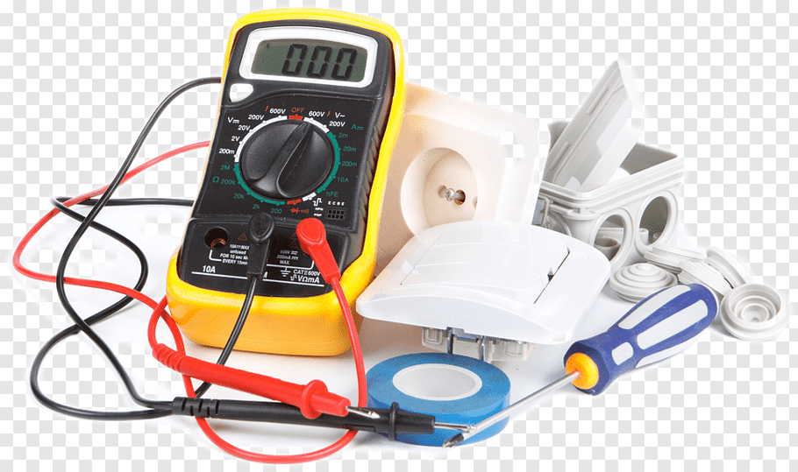
How to Protect Yourself
Perform two OSHA-required tests on all electrical equipment: test are required:
Before first use.
After any repairs, and before placing back in service.
After suspected damage, and before returning to use.
Notes:
How to Protect Yourself
Perform two OSHA-required tests on all electrical equipment: a continuity test, and a terminal connection test. Tests are required:
Before first use.
After any repairs, and before placing back in service.
After suspected damage, and before returning to use.
Every 3 months [for exceptions see, 29 CFR 1926.404(b)(1)(iii)(E)(4)].
Maintain a written record of the required tests, identifying all equipment that passed the test and the last date it was tested (or the testing interval). Like the program description, make it available to OSHA inspectors and affected persons upon demand.

Slide 8

How to Protect Yourself
How you can protect your workers
It is imperative that you provide either (i) GFCIs on the job sites for receptacle outlets in use and not as a part of the permanent wiring of the building or (ii) have a scheduled and recorded assured equipment grounding conductor program on construction sites which covers all cord sets, receptacles which are not part of the permanent wiring of the building or structure, and equipment connected by cord and plug which are available for use or used by the employees.
Electrocution remains the fourth leading cause of work-related death for construction workers, with one worker electrocuted on the job every day in the US
Notes:
How to Protect Yourself
How you can protect your workers
All companies need to follow OSHA ground-fault protection rules and regulations that are deemed necessary for employee safety and health. Therefore, it is imperative that you provide either (i) GFCIs on the job sites for receptacle outlets in use and not as a part of the permanent wiring of the building or (ii) have a scheduled and recorded assured equipment grounding conductor program on construction sites which covers all cord sets, receptacles which are not part of the permanent wiring of the building or structure, and equipment connected by cord and plug which are available for use or used by the employees.
You must provide the approved GFCIs for all l20-volt, single-phase, 15- and 20-ampere receptacle outlets on construction sites that are not a part of the permanent wiring of the building or structure and that are in use by employees. If there is any receptacle that is installed as a part of the permanent wiring of the building, then you must provide GFCI protection.
Electrocution remains the fourth leading cause of work-related death for construction workers, with one worker electrocuted on the job every day in the US. Although OHS professionals are not necessarily skilled electricians, OSHA provides an online guide to electrical safety for non-electricians that describes scenarios in which equipment like GFCIs are essential - for saving lives.

Slide 9

Final Word
The objective of the assured grounding program is to prevent electrocution by ensuring the grounding wire is electrically continuous from the power tool to the power source.
Notes:
Final Word
The objective of the assured grounding program is to prevent electrocution by ensuring the grounding wire is electrically continuous from the power tool to the power source.

